Slide 1
Subject – Verb Agreement

Slide 2
Subject-verb agreement means using the correct verb form with the subject:
Steve laughs (not “laugh”) a lot.
His friends cry (not “cries”) a lot.
My friends are (not “is” or “am”) in Kentucky.
Erin is (not “are” or “am”) a nurse.
Agreement is a problem only in the present & present perfect tense, except when using the verb “to be.” Remember that, except for “to be,” all persons take the same verb form in all tenses but the present & present perfect:
I/you/we/you/they talk BUT he (or she or it) talks
I/you/we/you/they have talked BUT he (or she or it) has talked
I/you/we/you/they talked AND he (or she or it) talked
I/you/we/you/they will talk AND he (or she or it) will talk
etc. (that is, all other tenses are just like the last 2 above)
The verb “to be” changes in the past as well as in the present & present perfect:
I am, was, have been we are, were, have been
you are, were, have been you(all) are, were, have been
he/she/it is, was, has been they are, were, have been

Slide 3
Subject-verb agreement isn’t particularly hard except in long sentences where the subject isn’t close to the verb. Most of the time, fortunately, we keep our verbs close to our subjects.
I was crying because my dog had run away.
Tony has seven classes.
Every time we eat Chinese, we are hungry an hour later.
Your sister isn’t going to believe what you did yesterday.
In all of the sentences above (some of which have more than one subject-verb set), the verb comes right after the subject. This is how we speak & write most frequently.
However, sometimes there is a phrase between the subject & verb:
The professor in the back of the classroom looking at a long line of fire ants teaches biology.
“Professor” is the subject, & “teaches” is the verb. But sometimes when there’s a long phrase (or series of phrases, as in this case) that separates the subject from the verb, we get lost & grab the noun that’s closest & make the verb go with that. That is, “ants” is much closer to “teaches” than “professor” is, & we might mistakenly say “…ants teach” instead of “teaches” (to go with “professor”). When you have a sentence like this in a paper you’re proofreading, you need to look for the subject & verb & make sure they go together.

Slide 4
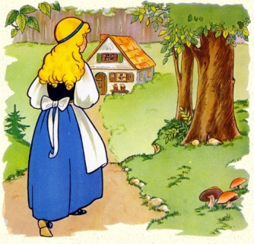
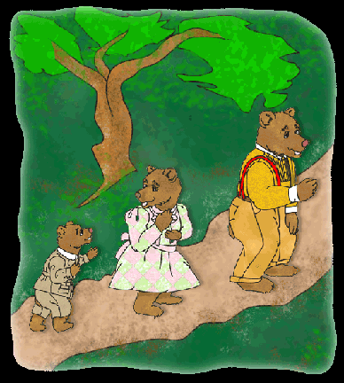
Another problem is that sometimes we put the subject AFTER the verb. Any time we use the phrase “there is (are/was/were),” the subject follows the verb:
Once upon a time there was a blonde girl who lived in the forest.
There were 3 bears who also lived in the forest.
There are other occasions when we may choose to have the subject follow the verb:
In come the 3 bears, hungry after their walk.
Near the beach is a shop with t-shirts.

Slide 5
Some INDEFINITE PRONOUNS are singular, & some can be singular or plural.
“Each,” “either,” & pronouns that end with “-one,” “-body,” and “-thing” are singular:
Everyone is here.
Nobody wants the licorice.
Either (option) is fine.
In the other cases, you have to decide if the indefinite pronoun is standing for a singular person/object or plural person/object:
Some (children) are smart.
Some (shampoo) is on the shelf.
Are any (men) available to help?
Is any (man) available to help?

Slide 6
Compound Subjects
Compound subjects can be joined by “and” or “or”:
Elisa, Tony, and Robert leave early.
She and I are friends.
The book and the pen belong to me.
When you combine 2 or more subjects with “and,” the verb HAS to be plural. But when you combine them with “or,” sometimes it’s singular, & sometimes it’s plural. It all depends on the subject that’s closest to the verb:
That boy or the girls know the truth.
BUT
The girls or that boy knows the truth.
In sentences above, you have a compound subject: boy – girls. In the first one, “girls” is closer to the verb, so the verb must agree with “girls.” But in the second, “boy” is closer to the verb, so the verb must agree with “boy.”

Slide 7
Sets of conjunctions called CORRELATIVE CONJUNCTIONS can also create compound subjects:
Both Elizabeth and her brother are going to the party.
Neither Elizabeth nor her brother is going to the party.
Either Elizabeth or her brother is going to the party.
Not only Elizabeth but also her brother is going to the party.
“Both…and” function like, unsurprisingly, “and”: you use a plural verb.
The other correlative conjunctions function like “or”: the subject that’s closer to the verb determines whether the verb is singular or plural. If the subject closer to the verb is singular, the verb is singular; if that subject is plural, the verb is plural.

Slide 8
It’s important to know that only “and, “or,” & the correlative conjunctions can create compound subjects. The following sentences do NOT contain compound subjects:
Dr. Smith, together with his partners, operates a successful practice.
Kate, along with the other cast members, does a great show.
The book—all 20 chapters—is incredibly boring.
The phrases between commas & dashes are just that: phrases, not part of the subject. You don’t consider the phrase at all when you’re deciding if the subject is singular or plural.

Slide 9
Now comes another problem: collective nouns.
A collective noun is a noun that is singular but refers to more than one:
group family audience
choir committee gang
jury herd team
Normally, these nouns are considered singular:
The committee meets on Fridays.
My family lives in Virginia.
My favorite team always wins.
According to most current guidelines, collective nouns can take a
plural verb if the members of the group are acting individually:
The committee argue at every meeting.
What that would mean is that the individual members of the committee are arguing with each other. You may find it more “comfortable” to actually say,
The committee members argue at every meeting.

Slide 10
Most nouns that look like they’re plural but that don’t have a singular form get a singular verb:
Linguistics is my specialty.
Mathematics is a different story.
Measles is a childhood disease.
In none of the above instances is can you take off the –s & still have a noun. Rather, in the first two, you have an adjective, & “measle” isn’t even a word.
Other nouns that look plural are considered plural, probably because we perceive them to be made up of two parts:
The scissors are on the desk.
The pants are in the closet.

Slide 11
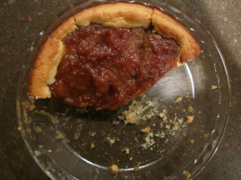
Numbers are a bit odd sometimes. Actually, you need to consider the word “number” itself:
The number of accidents is too high.
A number of accidents have occurred here.
When “the” precedes “number,” you need a singular verb.
When “a” precedes “number,” you need a plural verb.
Fractions can be singular or plural, & in this case, an object of a preposition tells us which:
Two-thirds of the students are here.
Two-thirds of the pie is too much for one person.
In the first example, “students” tells us we’re talking about individuals. In the second, “pie” tells us we’re talking about a whole. In short, if the fraction is followed by a preposition + PLURAL object, it’s considered plural; if it’s followed by a preposition + SINGULAR object, it’s considered singular.
The same is true with the word “majority” and “a lot” (which is NEVER a single word):
A majority of the students want to leave early.
A majority of the pie was eaten.
A lot of the students want to leave early.
A lot of the pie was eaten.

Slide 12
Think of the word “dollars.” Will it take a singular or plural verb?
Five dollars are a lot of money.
Five dollars is a lot of money.
The second sentence is, of course, the correct one. The reason is that we see “five dollars” as a unit. The same is true when we talk about time:
Two years is a long time to be out of the country.
Twenty weeks is too long for a semester.
However, if we’re talking about money/time as UNITS, we use the singular:
Five dollars were scattered across the room. (Obviously, we’re talking about five bills here.)
Two years during that decade were very important: 1927 & 1929.

Slide 13
Practice

Slide 14
Exercises
http://wwwnew.towson.edu/ows/exercises/Subject%20Verb%20Agreement%20-%20Exercise01.aspx
http://wwwnew.towson.edu/ows/exercises/Subject%20Verb%20Agreement%20-%20Exercise02.aspx
http://grammar.ccc.commnet.edu/grammar/cgi-shl/quiz.pl/sv_agr_quiz.htm
http://grammar.ccc.commnet.edu/grammar/quizzes/svagr3.html
http://www.wisc-online.com/Objects/ViewObject.aspx?ID=WCN3302
http://www.mhhe.com/socscience/english/langan/sentence_skills/exercises/ch09/p4exe.htm

